Slide 1



Team Project
Nakov's Dreams
Team NALINGS

Slide 2

AGENDA
Meet the team
Game Description
Visuals
Code
Further Dev
Demo
Questions

Slide 3
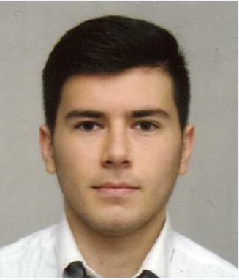
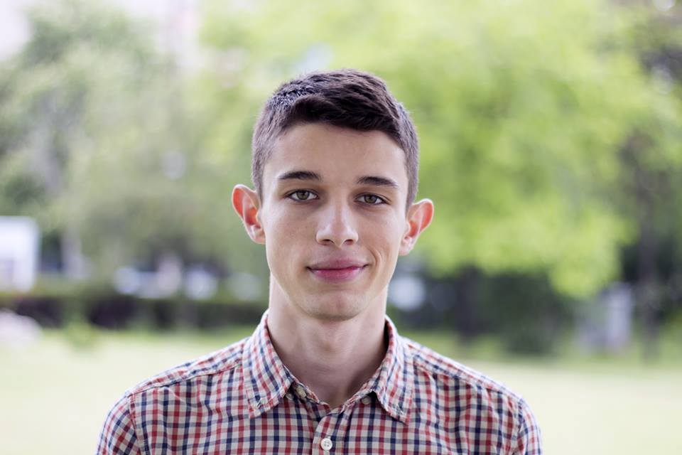
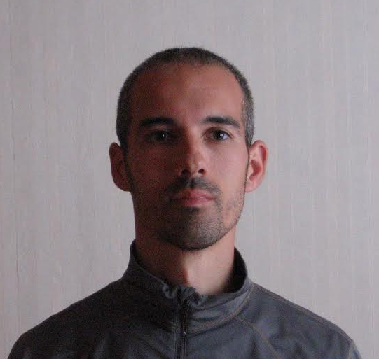
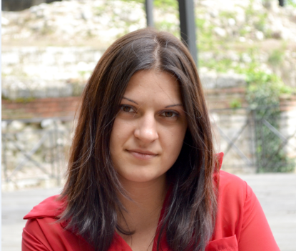
Meet the Team
BOBI
Project
Manager
SASHO
Coder Ninja
Na(i)lings
DENI
QA&Code
LUBO
QA&Code

Slide 4
Game Description
Purpose of the game: make Nakov fall asleep by counting sheep
Levels: Three
Logics: Each level is a new counting challenge. Each correct answer user is given with one point and a bonus life. Upon reaching a certain amount of points the user levels up.
The game ends when the user has no lives left or when he finally make Nakov fall asleep (reach the highest amount of points)

Slide 5
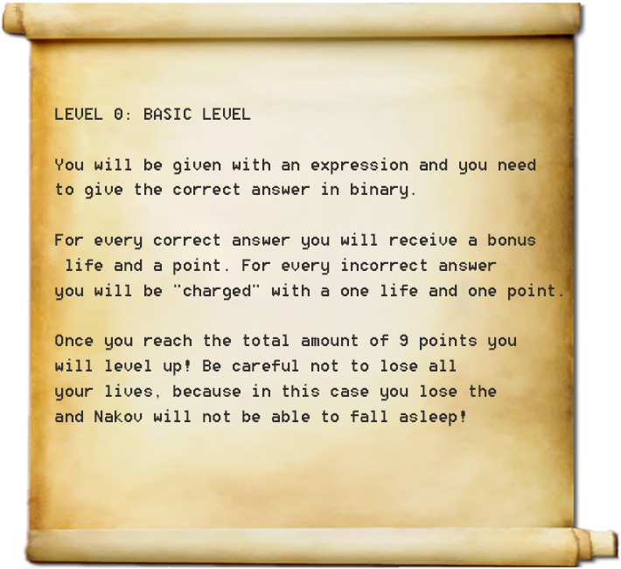

Slide 6
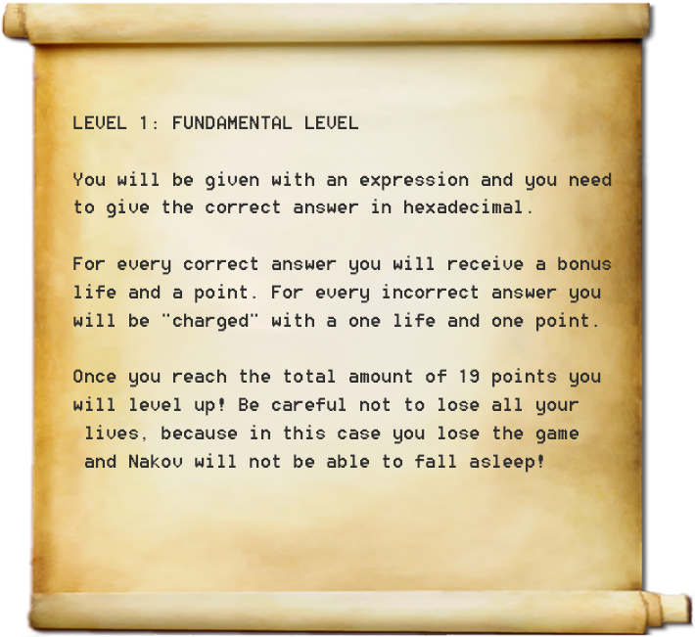

Slide 7
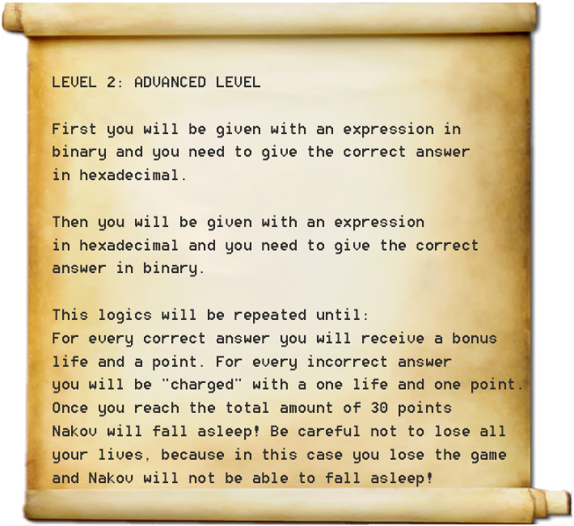

Slide 8
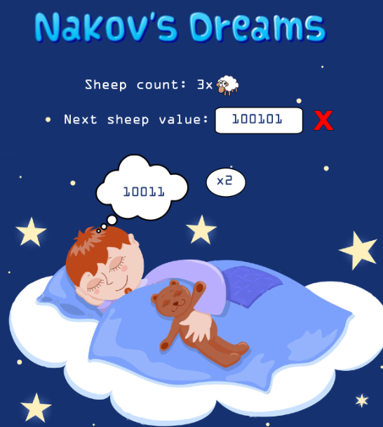

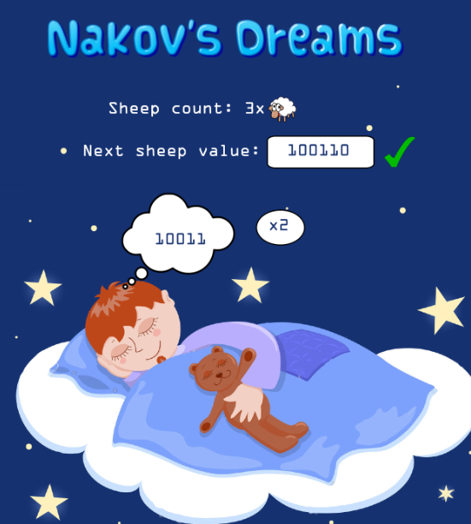
Visuals

Slide 9
Further Dev
Developing a mobile application – a special edition for maniac programmers who have developed insomnia (зарибени програмисти, страдащи от безсъние)
Online store of animals / hints / cheats
Online competitions

Slide 10
Demo

